Slide 1
CSE 474 - Group 14
Shamir Roy - 20241015
Tanzim Rahman Sabib - 23141078
ST FARAH
RA AMIT
Page - 01

Slide 2
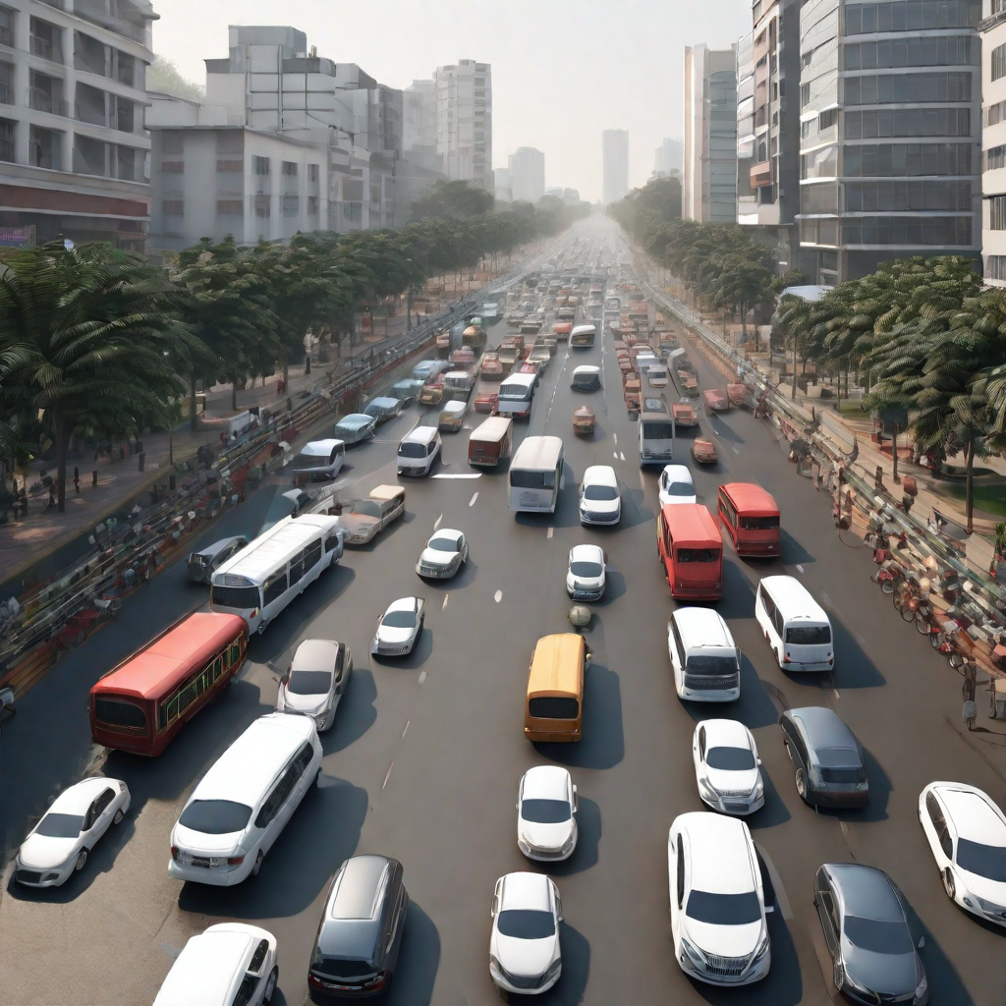
Simulating Traffic Flow in Dhaka City
Page - 02

Slide 3
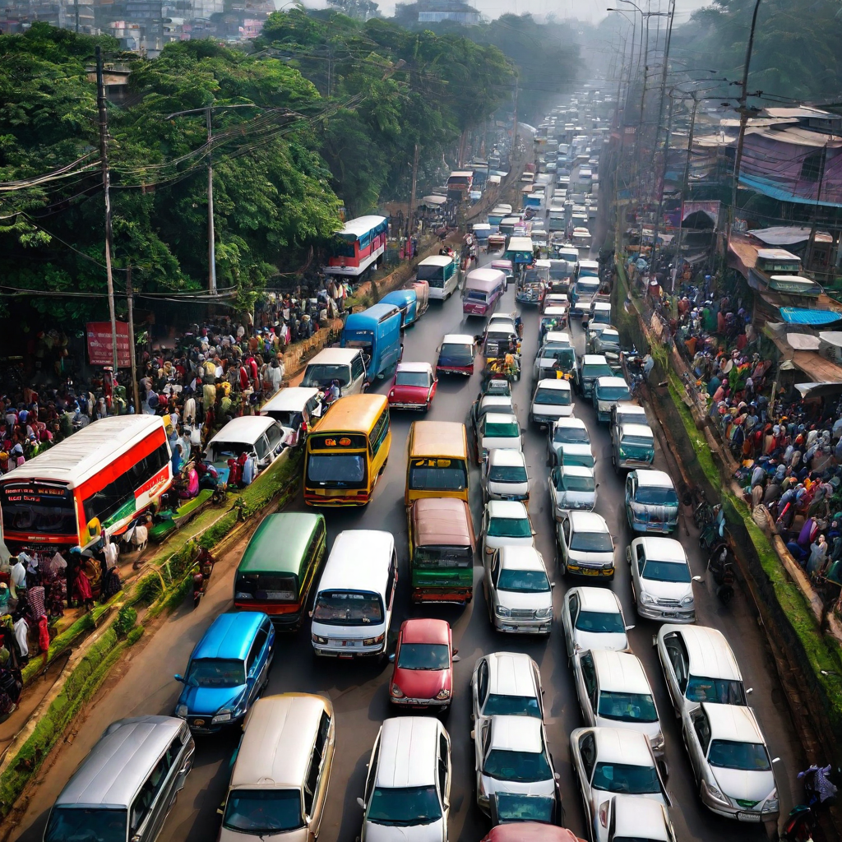
Introduction
Traffic congestion in Dhaka city is a significant issue. It leads to inconvenience, delays, and pollution. To tackle this problem, understanding traffic flow is crucial. Traffic simulation can analyze and model vehicle and pedestrian behavior, aiding in finding effective solutions. By testing different scenarios, we can enhance transportation in Dhaka and reduce congestion.
Page - 03

Slide 4
Why simulate Traffic Flow ?
The main reason behind simulating traffic flow is to generate data without real world. Instead of testing new ideas in real world we can simulate the traffic flow, test our new ideas there without having to interact with the real world. This helps accelerate the optimization and data gather of traffic systems. Simulation is much cheaper and faster alternative to real world testing. The few objectives of simulating traffic flow in Dhaka city are as follows:
To understand the traffic infrastructure in Dhaka city
The understand the causes and effects of traffic jams in Dhaka city
To find some effective solutions to traffic jams
Page - 04

Slide 5
Usefulness of traffic simulation
Traffic simulation is an important tool to enable planners to use available budgets and resources as efficiently as possible when expanding or reconstructing transportation systems. Simulation models help to understand the effects that different measures have on traffic volume and traffic flow under different circumstances. So, simulating traffic creates a solid basis for good and cost-effective decisions - making traffic and mobility safe, sustainable, equitable and resilient. In short, it helps to create future-oriented mobility. For example, the effectiveness of a flyover, bridge, tunnels or other systems can be measured using the traffic flow simulation and it helps take the most effective decision as possible and it also reduces unnecessary high costs of traffic projects. Traffic simulation also helps build more safer roads, flyover and other road stuffs.
Page - 05

Slide 6
Our plans
We have certain plans regarding this traffic simulation in Dhaka city such as -
Simulate traffic flow in major areas such as Mohakhali, Bijoy sarani, Banani to see how the number of traffics, speed, intersection affect traffic flow there.
To understand the cause and level of traffic jam.
To understand how to find some effective ways of solving traffic jam issue.
To understand how width of highway can affect traffic flow.
To gain enough knowledge from our simulation which we can use to find the ways of solving traffic jam.
Page - 09

Slide 7
Modeling
Traffic system models are classified into 3 categories such as -
Microscopic models - This represents every vehicle separately.
Macroscopic models - This describes the movement of vehicles as a whole in terms of traffic density and traffic flow.
Mesoscopic models - This is hybrid model that combines the features of both microscopic and macroscopic models. They model flow as “packets” of vehicles.
Page - 06

Slide 8
Literature Review
Traffic flow simulation crucial for understanding poor traffic infrastructure in Dhaka city.
Key for effective city planning, congestion management, and infrastructure development.
Dhaka's traffic conditions: extreme congestion, diverse vehicle types contribute to complexity.

Slide 9
Simulation Techniques:
Microscopic, macroscopic, and mesoscopic models employed in existing research.
Lack of comprehensive simulation addressing Dhaka's unique challenges.
Novelty in studying consequences of partial or total non-compliance with traffic rules.
Simulation Limitations:
Acknowledgment of simulation challenges and limitations.
Despite dissimilarity to Dhaka, simulation proves effective in offering insights.
Evaluation of potential impacts of new traffic infrastructures.

Slide 10
Paper Summaries
Pan and Cao (2018):
Emphasizes studying traffic flow in bus stop areas using VISSIM simulation software.
Investigates impact of bus arrival frequency and non-motor vehicle traffic volume.
Song and Min (2018):
Focuses on urban traffic analysis and simulation technology.
Introduces a traffic demand estimation process based on L1 regularized regression.
Lin (2019):
Introduces DynasTIM for real-time simulation and optimization of dynamic traffic flows.
Validated in Futian CBD, Shenzhen, China, showcasing a 13% reduction in average travel delay.
Skorobogatchenko et al. (2022):
Discusses automated traffic control systems and proposes the use of SUMO software.
Shows adaptive traffic control can increase overall road network capacity by 20-30%.
Potuzak (2022):
Provides a survey of existing methods for road traffic network division.
Maps and categorizes methods, serving as a valuable resource for researchers.

Slide 11
Research Gap and Aim:
Existing literature lacks a comprehensive simulation for Dhaka's traffic conditions.
Addressing non-compliance with traffic rules crucial for understanding Dhaka's chaotic traffic.
Urban Planning and Simulation Games:
Cities: Skylines utilized in urban planning research and education.
GeoSkylines modification offers geographically accurate visualizations.
Effectiveness of Cities: Skylines in teaching urban planning principles.

Slide 12
Studies on Cities: Skylines:
A. GeoSkylines, Pinos et al. (2020):
Creates geographically accurate visualizations within Cities: Skylines.
Enables export of game objects into GIS data format for data collection.
B. Urban Planning Education, Commey (2023).:
Cities: Skylines introduced into urban planning education.
Enhances students' understanding and critical thinking skills.
C. Computer Games in Education, Haaetl (2021):
Games, including Cities: Skylines, offer a simplified view of reality.
Well-thought modifications could enhance suitability for city planning scenarios.

Slide 13
Studies on Cities: Skylines:
D. Gamification of Urban Planning:
Evaluates the effectiveness of Cities: Skylines for teaching urban planning through gamification.
Fosters conceptual understanding, critical thinking, and problem-solving skills.
E. AI in City Design Optimization:
AI agent designed to optimize city layouts in Cities: Skylines.
Illustrates viability of using AI as a tool in urban planning for real cities.
Conclusion:
Integration of insights from these studies enriches understanding of gamification in education and urban planning.
Implications for educational and planning contexts explored through diverse perspectives.

Slide 14
Methodologies
For modeling the traffic flow in Dhaka city we have used microscopic models in which every vehicle is represented and the behaviour of every driver is duplicated. In microscopic models the Intelligent Driver model is used. Traffic flow is simulated using the intelligent driver model equations and other mathematical model equations that represent the whole traffic systems in the simulation. For simulation software , city sky line city builder was used in which a custom Dhaka city was built and the traffic systems of Dhaka city was replicated. Thus the Dhaka city roads, highways were replicated and this is how the simulation was done.

